Slide 1
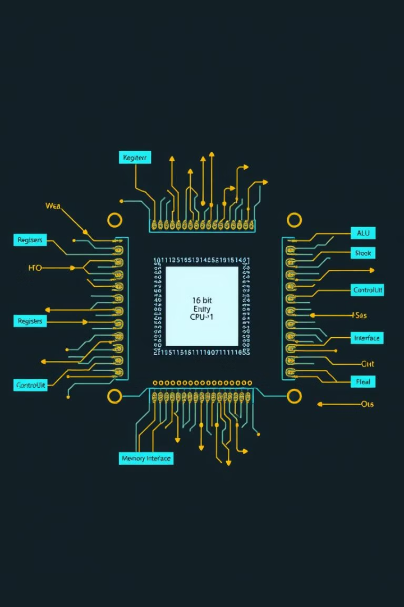
Design and Simulation of a 16-Bit Computer Using Logisim Evolution
Presented by: Ahmad Rayan Qasim, Abdul Kabir Syed, Attique Alvi, Abdul Samad
Course: EE123 - Digital Logic Design
Supervisor: Prof. Mughees Ahmad
Submission Date: 17 June 2025

Slide 2

Project Overview
Objective
Build a 16-bit computer from basic components.
Tool
Logisim Evolution for simulation.
Method
Designing from scratch, no pre-made CPUs.
Focus
Instruction cycle, data processing, control flow.

Slide 3






Main Components
ALU
Registers
RAM
Program Counter
Arithmetic and logical operations.
Temporary data storage.
Stores instructions and data.
Points to next instruction.
Control Unit
Clock
Directs CPU operations.
Synchronizes all operations.

Slide 4





Additional Components (New Additions)
Instruction Register (IR)
Holds current fetched instruction.
Flags Register
Stores status flags (Z, C, N, V).
Stack Pointer (SP)
Points to stack top for calls/state.
MAR
Memory Address Register for R/W.
MUX
Directs signals between components.

Slide 5
How the Instruction Cycle Works
Fetch
PC sends address to RAM; instruction to IR.
Decode
Control Unit interprets instruction.
Execute
ALU/data path components carry out.
Store
Result saved in Register or RAM.
PC Increments
Points to next instruction.

Slide 6
ALU and Flag Register
ALU Capabilities
Flag Register
Add, Subtract
Zero (Z)
AND, OR, NOT, XOR
Carry (C)
Outputs: Result + Flag signals
Negative (N)
Overflow (V)
Used for conditional branching

Slide 7
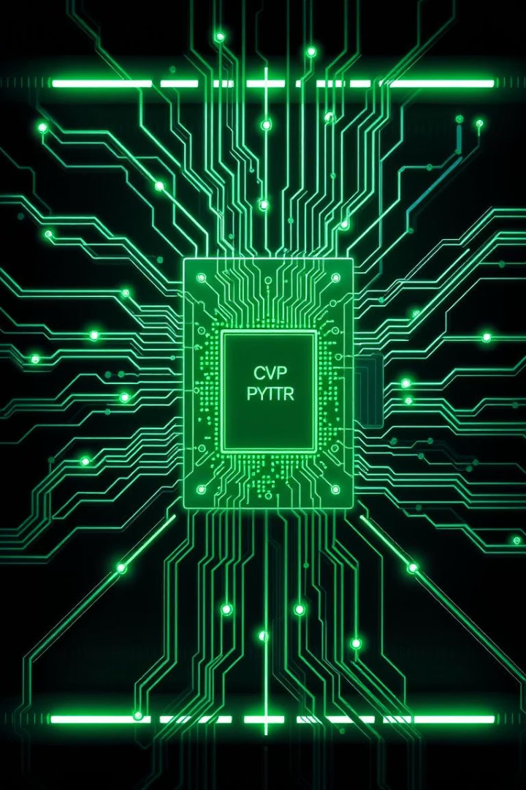
Control Unit & Microoperations
Control Unit
Decodes instruction opcode. Triggers micro-operations.
Micro-operations
Enable Register → ALU. Write RAM → Register. PC + 1 → PC.

Slide 8
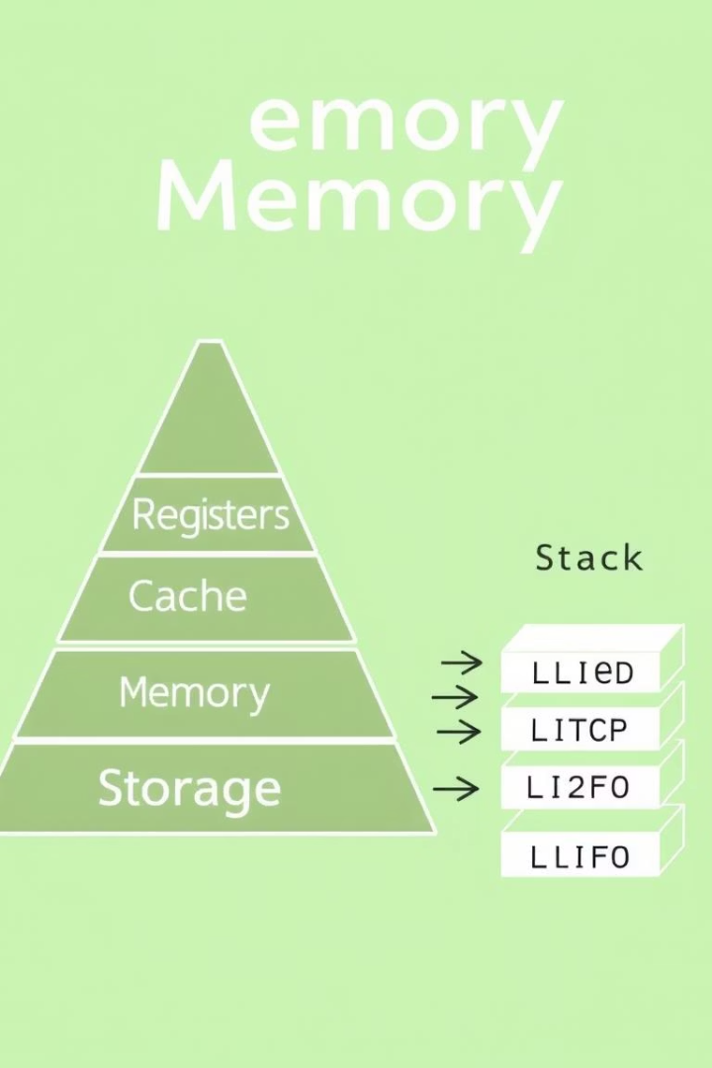
Memory & Stack Operations
1
2
RAM
Stack
Stores programs and data. Addressed by MAR, via data bus.
Push/Pop operations via SP. Supports subroutines.

Slide 9
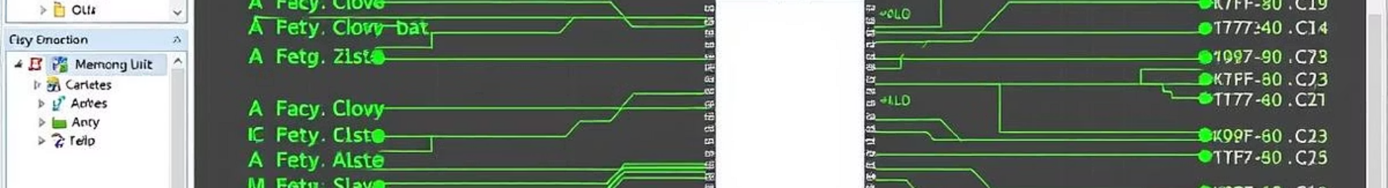
Simulation & Results
Test Programs
1
Addition, Subtraction, Comparison. Register ↔ RAM data transfer.
2
Instruction Cycle
Observed in real time.
ALU Accuracy
3
Accurate logic/arithmetic.
4
Synchronization
All components worked synchronously via Clock.

Slide 10
Conclusion & Future Work
Conclusion
Future Enhancements
Functional simulated 16-bit computer
Add I/O devices (Keyboard, Display)
Hands-on learning of hardware concepts
Implement Interrupts & System Calls
Expand instruction set
Create graphical assembler/interface

